Slide 1
Troy Street Project
City of Lemon Grove Council Workshop Presentation
Marko Medved, Director, Dept. of General Services
Scott Christman, Deputy Director, Dept. of General Services
Dijana Beck, Director, Office of Homeless Solutions
March 4, 2025

Slide 2
Background Information
2018 County Declares Shelter Crisis
2019-2021 County searches over 1,300 sites for potential interim housing use
2022 County narrows down the list of viable sites to less than a dozen that meet both development and program requirements
2023 County and State began planning for Governor’s sleeping cabins project
2024 County Board of Supervisors approves Troy St project

Slide 3
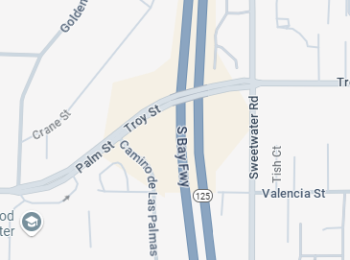
Location
Lemon Grove
Spring Valley

Slide 4
Location

Slide 5
Project Timeline
Today

Slide 6
Public Feedback in Design
SR-125
Troy Street
👁
Sweetwater Road

Slide 7
Public Feedback in Design
SR-125
Restrooms with showers
Troy Street
Pavilion
Queuing area for incoming cars
Sweetwater Road

Slide 8
Design
SR-125
Admin
Laundry
Storage
Troy Street
Security Office
Pavilions
Pet Area
Sweetwater Road

Slide 9
Design
Pavilion
Security Office
Ornamental Fencing & Landscaping
Sidewalk

Slide 10
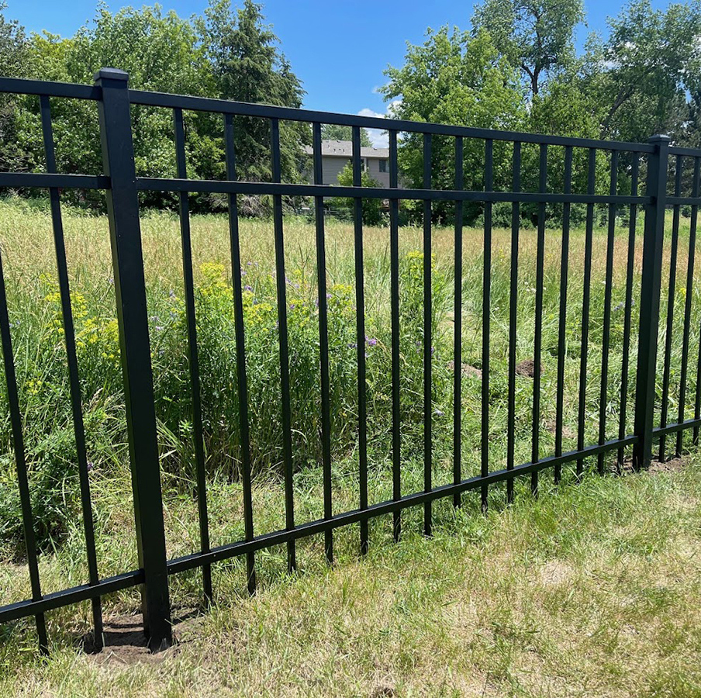
Design
SR-125
Sweetwater Road
Ornamental Fencing
Troy Street

Slide 11
Street View from SR-125 Overpass

Slide 12
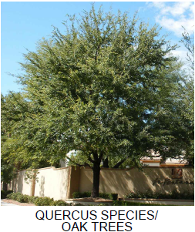
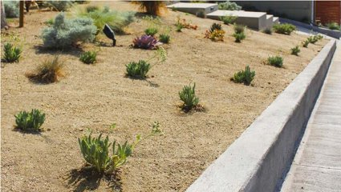
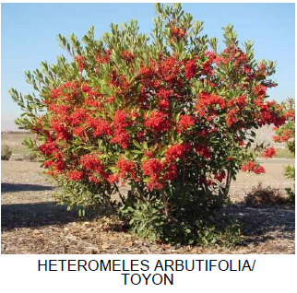
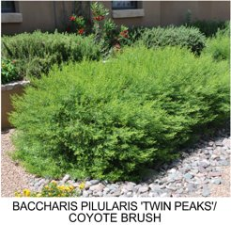
Landscaping
Decomposed Granite

Slide 13
On-Site Parking
Spaces | Use
3 | Volunteers & Visiting Service Providers
2 | Security Guards
2 | Site Supervisor & Program Manager
2 | Case Managers
2 | Office Support & Behavioral Health Specialist
1 | Healthcare Aide
1 | Accessible ADA Space
13 | Total
3
4
4
2

Slide 14
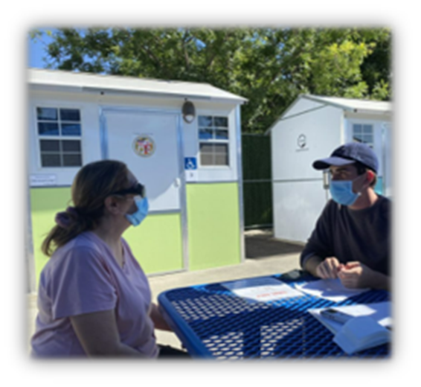
Program Design
Approximately 60 units as interim housing for unsheltered Veterans, Seniors, Transitional Aged Youth and Adults
Coordinated referrals and intakes into program by County's Office of Homeless Solutions
Program excludes people with certain criminal background such as registered sex offenders, arsonists, or active felony warrants.
$11.1M one-time funding for planning, design, and construction, $3M ongoing annual operations costs

Slide 15
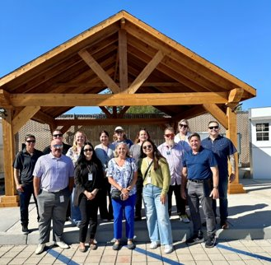
Program Design
This community will include 24-hour security and site management, site maintenance, hygiene facilities, internet, meals, picnic areas, dog run, and enrichment activities
Program includes case management, housing navigation to permanent housing options, access to behavioral health, employment support services, credit repair and many other supportive services

Slide 16
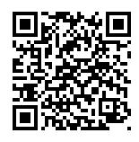
Troy Street Project
Q&A
Site Information Available: EngageSanDiegoCounty.gov

